Slide 1
How to Make a Toon in Toondoo!

Slide 2
Create an Account
To create an account, click on Sign up in the upper left hand corner of your screen

Slide 3
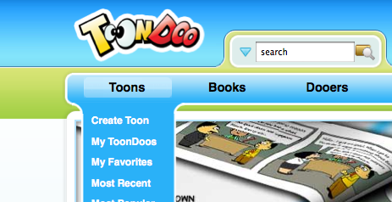
Make a Toon
Go to the drop down menu in the upper left hand corner, under Toons and select Make a Toon

Slide 4
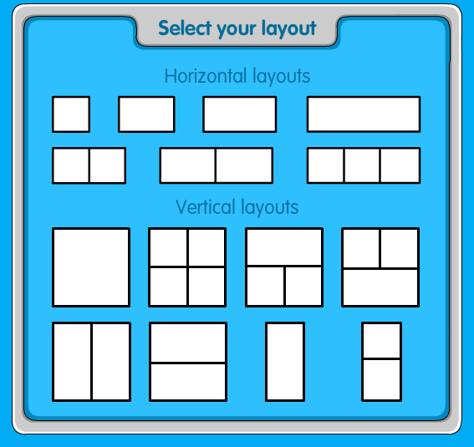
Select Your Layout

Slide 5
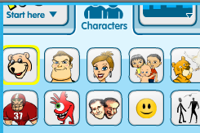
Select your characters; There are tons to choose from!

Slide 6
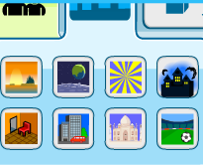
Select your background

Slide 7
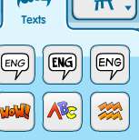
Select your text bubbles

Slide 8
Create your toon!!
Use the different tools at the top to add things to your toon
Use the tool bar at the bottom to edit your toon by enlarging, changing direction, etc.

Slide 9
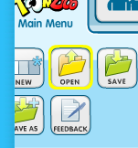
When you’re done, save your toon!
Go to the upper left hand corner and select save under the main menu

Slide 10
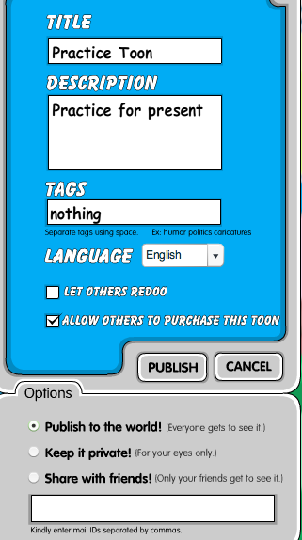
Fill in the Save information
Fill in what you want to name your comic, give it a brief description, add a tag if you like, and click the box let others redo (so no one can change your comic)
You can choose to
Publish to the world
Or keep private.
Hit publish and you’re done!

Slide 11
Remember to Save your Work!!
And to write down what you named it so the teacher can find it later!
Have fun!!!!!

