Slide 1
Pixton
www.pixton.com

Slide 2
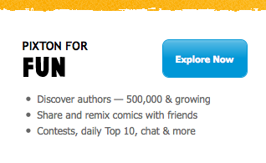
Create an account
Go to www.pixton.com
Go to the explore now at the bottom of the screen

Slide 3
Join
Go to Join now at the top of the screen

Slide 4
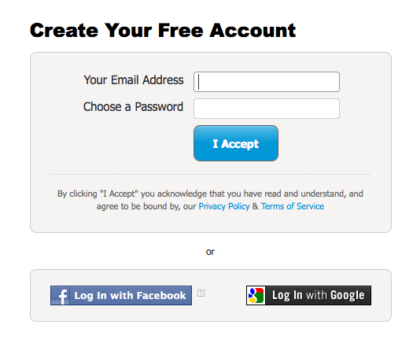
Enter your information
Enter your email and a password you would like to use

Slide 5
Select Create a Comic

Slide 6
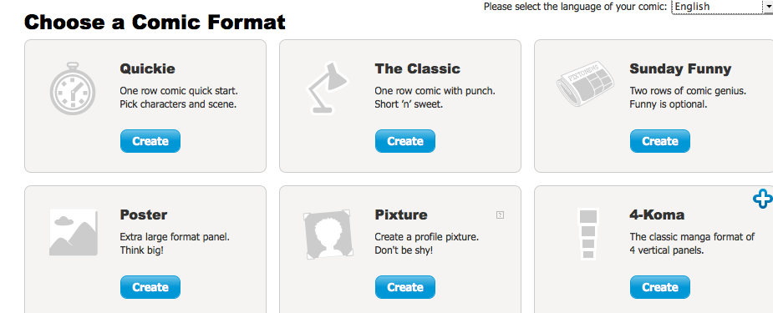
Select a Format
For your first comic, I suggest one of the first two formats because they are quick and easy. You can play around and see which you prefer!

Slide 7
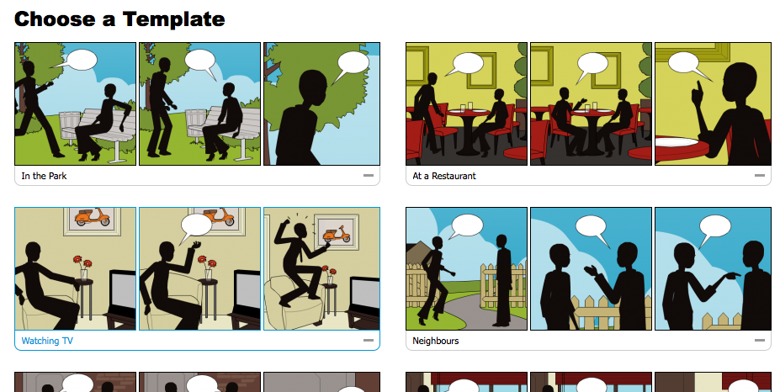
Choose a Template
Whichever you like-there are many to choose from!

Slide 8
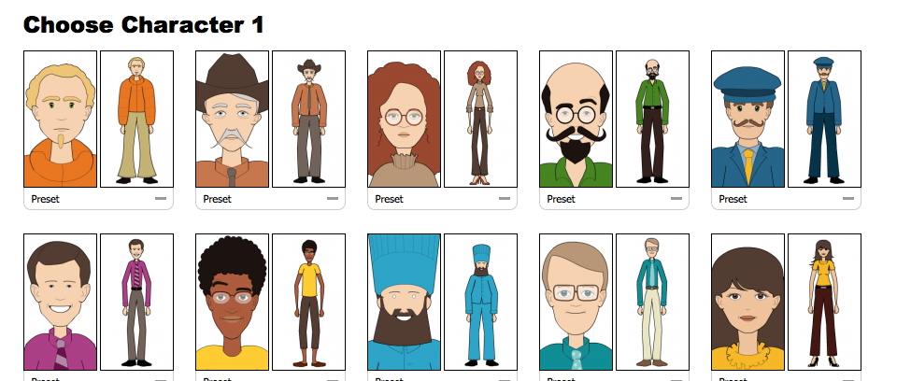
Choose your Characters
There is more than one character in your strips, because the characters are speaking with each other. Choose the different ones you would like.

Slide 9
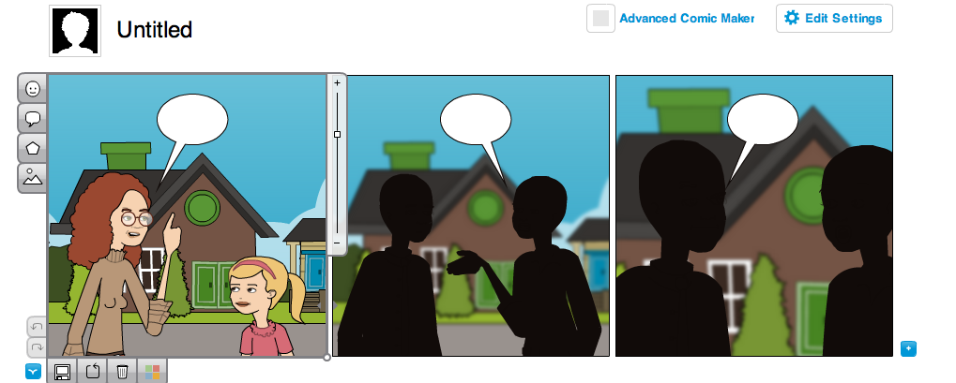
Edit your comic
To add the characters you chose, simply click where it says “click to edit”

Slide 10
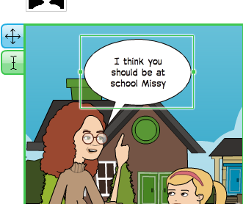
Add Text
Add text to the speech bubbles by double clicking and typing text in them

Slide 11
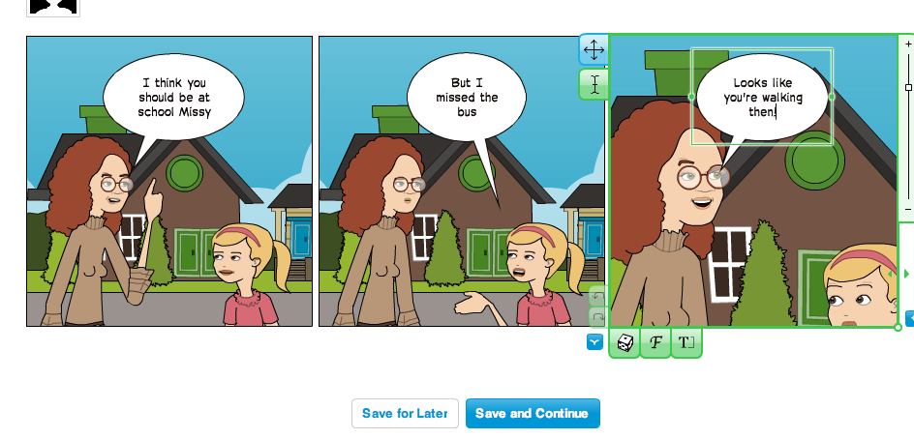
Edit and Save
Once you’ve added text, you can edit your comic by using the tabs around each frame.
Once you have your comic how you would like it, click save.

Slide 12
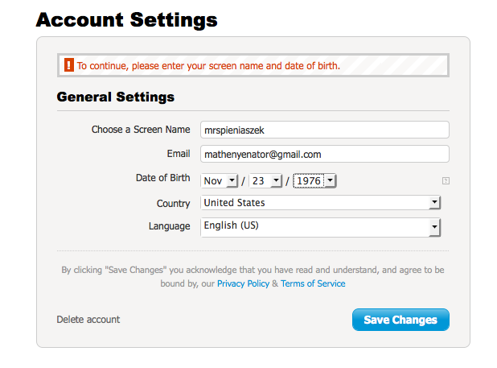
It will ask for additional info…
Fill in the screen name you would like, and your birthday

Slide 13
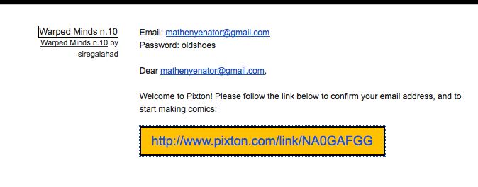
You have to go to your email
And confirm that it is your email account.

Slide 14
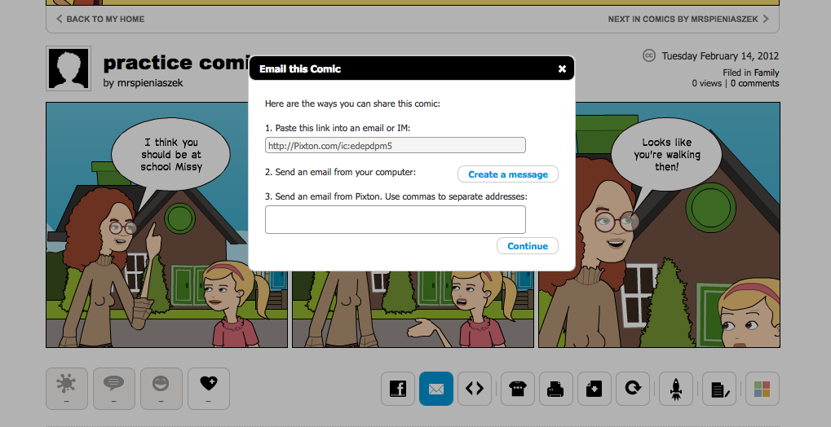
You’re done!
Once you’ve confirmed your email, your comic is saved under “My comics”
You can share the comic in many ways, by email, or with the link they give you

