Slide 1
Comic Life

Slide 2
Open comic life
Click on the icon on your desktop

Slide 3
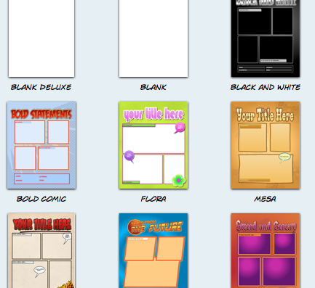
Choose a Template
There are TONS of choices. Choose the one that will fit your story the best. Simply click on the template you like.

Slide 4
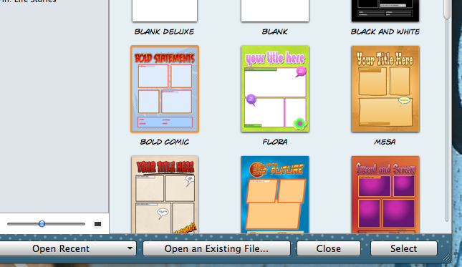
Hit select
Once you have clicked on your template, click on select

Slide 5
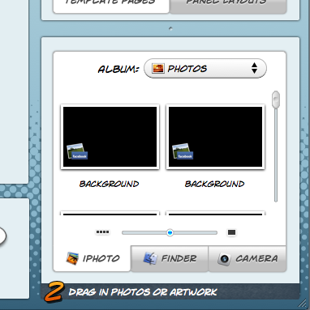
Choose your Pictures
Choose the pictures you want in your comic from your photos, and drag and drop them in the spaces provided.

Slide 6
Add your text
Choose a text bubble and drag it where you want it in the comic. Then click inside to add your text!

Slide 7
Edit your comic
Use the editing bar at the top to make your comic exactly how you like it.

Slide 8
Save your Comic
When you finish your comic, select save at the top left hand corner of the editing bar. You could also email it, print it, or publish it to your facebook!

Slide 9
So easy!!
It’s so easy!!
Have fun creating comics with your pictures!

